Slide 1
Starting Your Journey With Retrieval Augmented Generation
Overcoming hallucinations with your first real step beyond prompt engineering

Slide 2
Rag lecture agenda
01 The Stages of AI
// 1.0 - GUI / API
// 1.5 - RAG
// 2.0 - Agents
03 RAG-Fusion
// Multi-query
// Reciprocal Ranking
07 RAFT
// Fine-Tuning
08 Agentic RAG
// Using Agents to Achieve RAG
04 RAPTOR
// Spine-Leaf ?
02 Retrieval Augmented Generation
// 6 Step Process
// Embeddings (Vectors)
// Storage
// Retrieval
09 Agents using RAG​
// Agentic RAG
// Tool Selection
05 GraphRAG
// Knowledge Graphs
06 TAG
// Tables

Slide 3
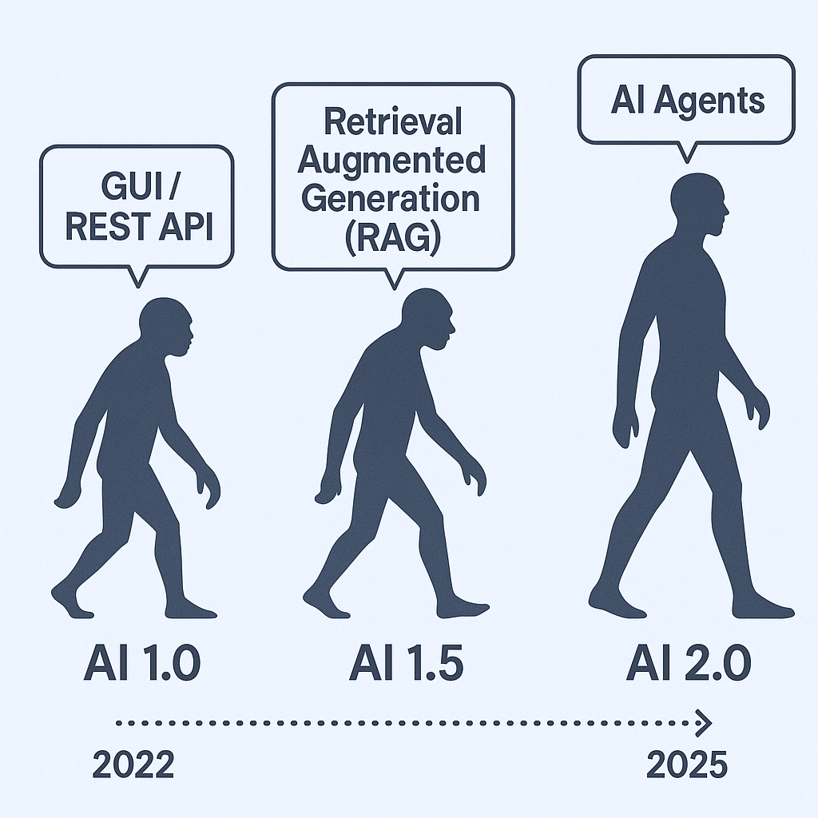

Slide 4
AI 1.0: GUI / REST API
The beginning of modern AI integration into workflows. Interfaces were built around graphical user interfaces (GUI) and REST APIs. Systems were reactive, rule-based, and required precise inputs.
Characteristics
Manual interactions via UI
Predefined API endpoints
No contextual understanding
Automation limited to basic scripting

Slide 5
AI 1.5: Retrieval Approaches
A leap in capability with large language models able to retrieve and reason over external data. Systems began to offer contextual responses grounded in current or proprietary knowledge.
Characteristics
Combines LLMs with external data sources
Supports context-aware Q&A
Introduces knowledge grounding
Still linear, not autonomous

Slide 6
AI 2.0: ReACT Agents (AI Agents)
The emergence of autonomous, goal-driven agents capable of planning, reasoning, and taking actions across multiple tools. Systems evolve from stateless prompts to stateful workflows.
Characteristics
Task orchestration and tool use
Memory and planning
Multi-step reasoning
Autonomous execution across APIs, files, and platforms

Slide 7
6 Steps of Retrieval Augmented Generation

Slide 9
01 Source
The source of the external knowledge you want to augment the generation of output.
High Level Categories
Webpages
PDFs
Cloud Providers
Social Platforms
Messaging Services
Productivity Tools
Common File Types
CSV
Directory of files
Unstructured files
JSON
HTML

Slide 10
02 Load
Once you have a source you need to find the appropriate loader
Sample code to load a JSON file:
from langchain_community.document_loaders import JSONLoader
file_path='./sample.json'
loader = JSONLoader( file_path=file_path, jq_schema='.quiz', text_content=False)
docs = loader.load() print(docs[0].page_content[:100]) print(docs[0].metadata)
For all loaders: ​ Document loaders | 🦜️🔗 LangChain​
document_loaders — 🦜🔗 LangChain documentation

Slide 11
03 split (transform)
A semantic splitter breaks text into chunks based on meaning, not just size or structure. It uses LLMs or embeddings to find natural boundaries—like a shift in topic, tone, or idea—rather than blindly splitting by paragraphs, headers, or token limits.
Example: Network Engineering Manual
Imagine you're using RAG on a 50-page Cisco IOS XE config guide.
Naive Splitter
Splits every 500 tokens. This might:
Split a show ip interface brief explanation halfway.
Mix unrelated topics like BGP and EIGRP in the same chunk.
Semantic Splitter
Analyzes where the concept changes and chunks accordingly:
One chunk for show ip interface brief
Another for configure static routing
Another for EIGRP authentication
This ensures each chunk is coherent, self-contained, and relevant to a single question.

Slide 12
03 split (transform)
A Note on Splitting
We are entering a bit of a recursive inception like dependency on Artificial Intelligence models being used to improve the outcomes from further models downstream.
To wit; an embeddings model is used to semantically chunk the data that is then transformed with an embeddings model into vectors (embeddings) (next step) and then a large language model can perform semantic lookups from the user prompt against the vectors (embeddings) (to be explained later).
Idea being its turtles all the way down .. use AI to help AI outcomes

Slide 13
04 Embed
Embedding models transform human language into a format that machines can understand and compare with speed and accuracy. These models take text as input and produce a fixed-length array of numbers, a numerical fingerprint of the text's semantic meaning. Embeddings allow search system to find relevant documents not just based on keyword matches, but on semantic understanding.
Input
"How do I configure BGP authentication?"
Output
[0.12, -0.87, 0.45, ..., 0.33] ← fixed-length vector
Similar vectors → semantically similar content

Slide 14
02 Provides a way to measure similarity between texts
Document
Document Embedding
Document Embedding
[0.1, 0.2 ….]
Similarity Metric
[0.1, 0.2 ….]
Question
Embedding
Embedding
01 Embeded text as a vector
Embedding models | 🦜️🔗 LangChain

Slide 15
05 store
Now that we have lists of floating point numbers, the vectors, we need to store them either in memory or in a database (or both). This database is optimized for storing and searching embeddings (numerical vectors). Enabling fast similarity search to retrieve relevant documents based on semantic meaning.
ChromaDB, FAISS, Weaviate, Pinecone, Elastic, Qdrant, Milvus
We will be using ChromDB, locally, privately, for our labs
I also really like Elastic because you get the “ELK” (Elastic, Logstash, Kibana) stack - meaning you can visualize and inspect much easier

Slide 16
06 Retrieve
Finally the Large Language Model (LLM) gets involved in the process and the prompt is transformed into vectors and a similarity search is performed between the prompt and the vector store returning the closest vectors to augment the generation of output.

Slide 17
RAG
Multi-Query

Slide 18
People ask stupid questions!
Can we take the users original question and derive +n number of similar questions.
Similar or different in:
Tone
Sentiment
Word selection
Sophistication
Technical accuracy
We can use AI to generate additional, similar, prompts to help AI generate the best possible answer to the original prompt.

Slide 19
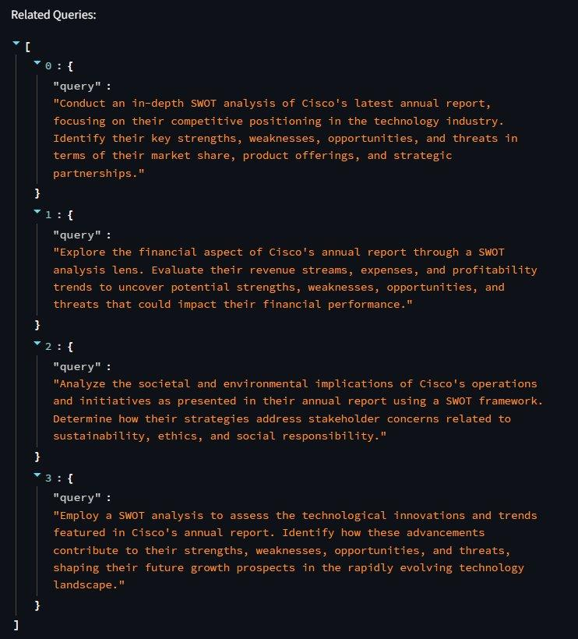


Slide 20
Multi-query: Augment the prompt
rag-from-scratch/rag_from_scratch_5_to_9.ipynb at main · langchain-ai/rag-from-scratch · GitHub

Slide 21
RAG
Fusion

Slide 22
Reciprocal Re-Ranking
RAG Fusion
Re-implemented from this GitHub repo, all credit to original author
RAG-Fusion, a search methodology that aims to bridge the gap between traditional search paradigms and the multifaceted dimensions of human queries. Inspired by the capabilities of Retrieval Augmented Generation (RAG), this project goes a step further by employing multiple query generation and Reciprocal Rank Fusion to re-rank search results.

Slide 23
Synthetic Answers
Going a step further we can use reciprocal ranking and other methods to evaluate and rank the 'best' answers
We can take 'all' answers and synthesize a 'best' answer
We can round-robin against multi-LLM to get different 'perspectives' and generations; and synthesize a multi-LLM council of answers
We can bounce the initial answers from all LLMs against all other LLMs and come to a consensus of the 'best' answer (and throw away outlying hallucinations

Slide 24
RAG-Fusion

Slide 25
RAPTOR
Recursive Abstractive Processing for Tree-Organized Retrieval

Slide 26
The drawbacks of RAG
Nevertheless, existing retrieval-augmented approaches also have flaws. The one we tackle is that most existing methods retrieve only a few short, contiguous text chunks, which limits their ability to represent and leverage large-scale discourse structure. This is particularly relevant for thematic questions that require integrating knowledge from multiple parts of a text, such as understanding an entire book, as in the NarrativeQA dataset (Kočiský et al., 2018). Consider the fairy tale of Cinderella, and the question "How did Cinderella reach her happy ending?". The top-k retrieved short contiguous texts will not contain enough context to answer the question.
RAPTOR: Recursive Abstractive Processing for Tree-Organized Retrieval (arxiv.org)

Slide 27
Look familiar?

Slide 29
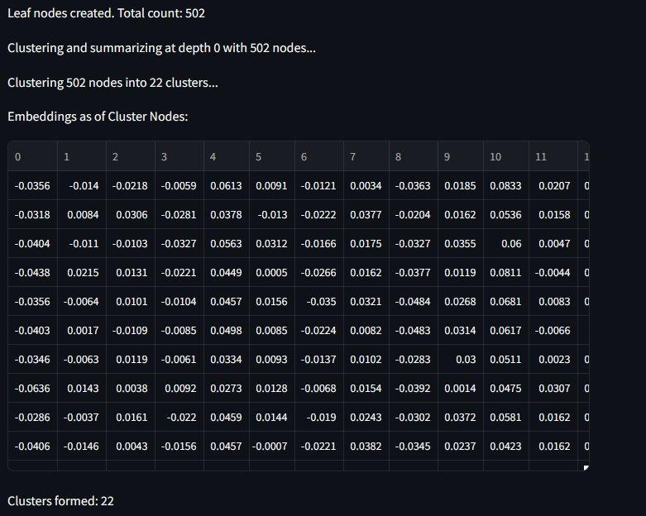
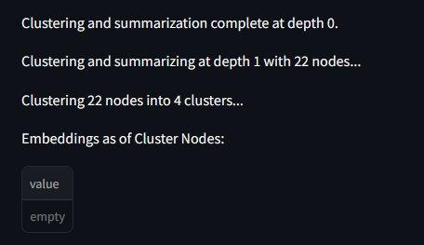
Document RAPTOR
Automated AI Summarization & Analysis and Chat with your Documents!
Leaf Nodes
22 Spines
4 Spines
Root

Slide 30
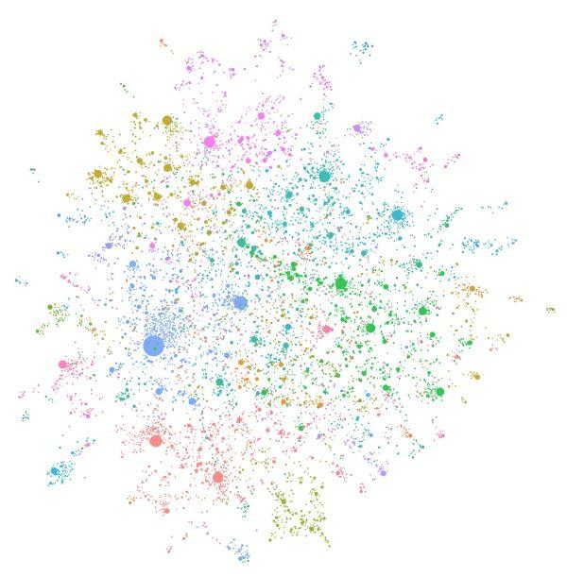
Graph rag

Slide 31
Knowledge Graphs
Baseline RAG struggles to connect the dots. This happens when answering a question requires traversing disparate pieces of information through their shared attributes in order to provide new synthesized insights.
Baseline RAG performs poorly when being asked to holistically understand summarized semantic concepts over large data collections or even singular large documents.
The LLM processes the entire private dataset, creating references to all entities and relationships within the source data, which are then used to create an LLM-generated knowledge graph.
This graph is then used to create a bottom-up clustering that organizes the data hierarchically into semantic clusters (indicated by using color in Figure 3 below). This partitioning allows for pre-summarization of semantic concepts and themes, which aids in holistic understanding of the dataset.
At query time, both of these structures are used to provide materials for the LLM context window when answering a question.
GraphRAG: Unlocking LLM discovery on narrative private data - Microsoft Research

Slide 32
** Warning **

Slide 33
graphRAG is *very* expensive
As you can imagine these graphs are huge and require a lot of computational and GPU power.
I abandoned my first attempt at GraphRAG after the job / bill reached about $65 – and it wasn't even close to being finished
Local models (LLMs) via tools like Ollama can ease the costs but they will still take substantial amount of time to generate locally unless you have serious GPU access
Be careful with cloud models when trying to build Knowledge Graphs

Slide 34
TAG
Table Augmented Retrieval

Slide 35
Beyond Text2SQL
Tabular data is already organized; structured; and can be queried with Structured Query Language (SQL)
Attempts to move to Text2SQL still cumbersome
LLM and a similar approach as RAG lets up lookup Tabular data in a similar way

Slide 36
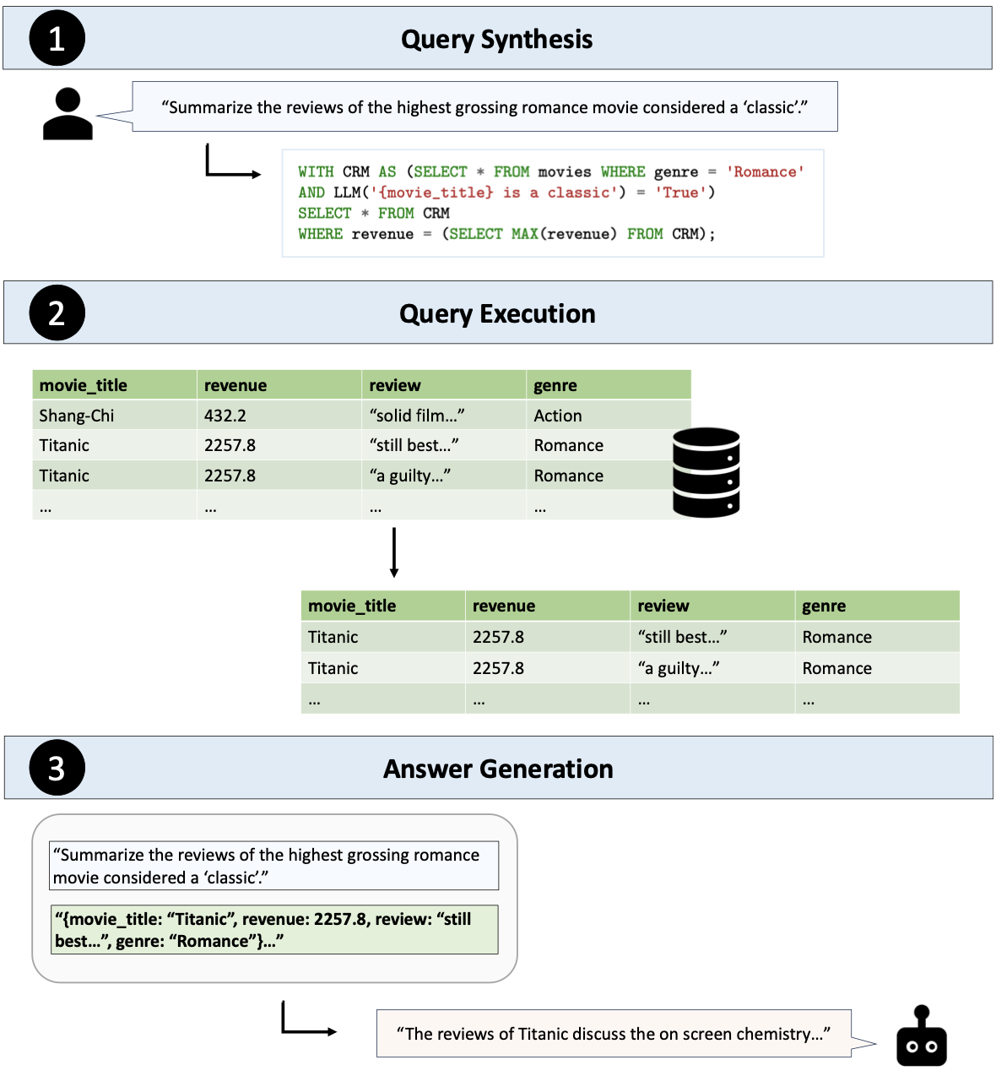
Text2SQL is Not Enough: Unifying AI and Databases with TAG

Slide 37
RAFT
Retrieval Augmented Fine-Tuning

Slide 38
Fine-Tuning: We can teach models
Fine-tuning is the process of taking a pre-trained machine learning model and further training it on a smaller, targeted, domain-specific, data set. The aim of fine-tuning is to maintain the original capabilities of a pretrained model while adapting it to suit more specialized use cases.
Setup: Loading our dataset and filtering down to one domain to fine-tune on.
Data preparation: Preparing your data for fine-tuning by creating training and validation examples, and uploading them to the Files endpoint.
Fine-tuning: Creating your fine-tuned model.
Inference: Using your fine-tuned model for inference on new inputs.
https://github.com/openai/openai-cookbook/blob/main/examples/How_to_finetune_chat_models.ipynb

Slide 39
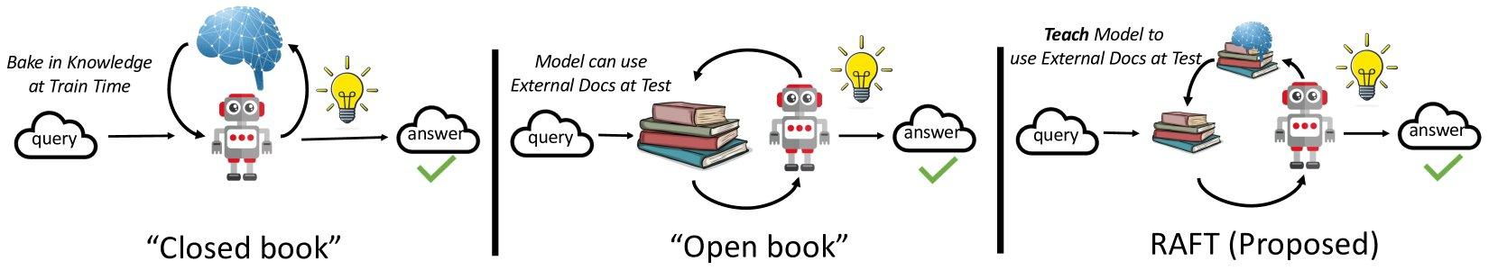
We can, recursively, use RAG to Fine Tune
RAFT: Adapting Language Model to Domain Specific RAG (arxiv.org)
RAFT (Retrieval Augmented Fine-tuning): A new way to teach LLMs (Large Language Models) to be better at RAG (Retrieval Augmented Generation) (microsoft.com)

Slide 40
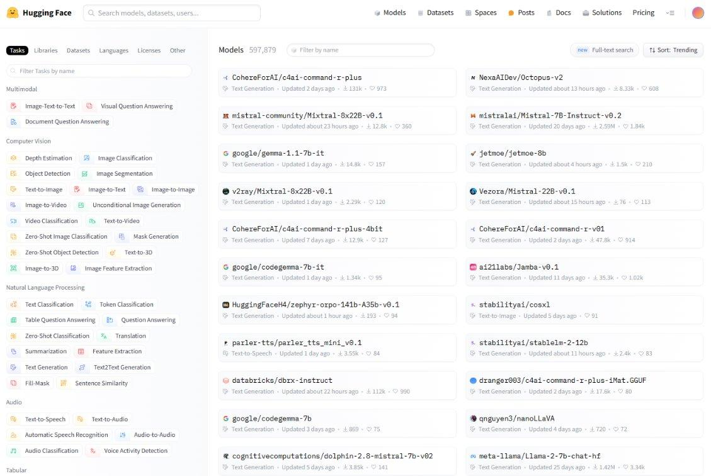
HuggingFace
A GitHub-Like Repo for Open Source Model

Slide 41
Agentic RAG
Using Agents to build RAG for … Agents

Slide 42
Agentic RAG
Much like how splitting / chunking text has been augmented itself by AI; why not let AI Agents help determine what text should be vectorized and stored
Recursive approach where you give your agent access to the source and let the Agent chunk and vector and store even better than human manual process
Ensure vectors are the best they can be and organized and chunked and stored by an Agent
Other agents / retrievals now use Agentic RAG source
https://github.com/openai/openai-cookbook/blob/main/examples/How_to_finetune_chat_models.ipynb

Slide 43
AI Agents
Using RAG

Slide 45
Questions?

Slide 46
Resources
Buddies (Basic RAG) – Document, Packet
automateyournetwork/Document_Buddy: Chat with various documents - XLSX, DOCX, PPTX, CSV, PDF, TXT - using chatGPT 4 Turbo and Langchain
automateyournetwork/packet_buddy: pcap analysis provided by chatGPT4 Turbo
RAPTORs – Document, Packet automateyournetwork/Document_RAPTOR: A RAPTOR Tree of your documents used for Language Model Retrieval to chat with the documents!
automateyournetwork/packet_raptor: An AI Assistant using RAPTOR to talk to .pcaps
Knowledge Graphs (GraphRAG) - Document, Packet
automateyournetwork/Document_graphRAG: graphRAG approach with .pcap
automateyournetwork/packet_graph: A Knowledge Graph of a .pcap Packet Capture!
TAG - Packet automateyournetwork/Packet_TAG: Table Augmented Generation (TAG) with Packet Captures (.pcaps/pcapng)

Slide 47
Before we do the Labs I have good / bad news

Slide 48
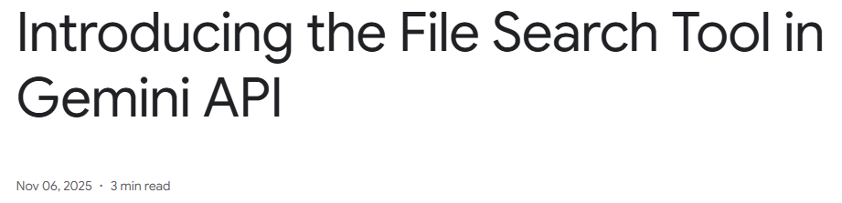
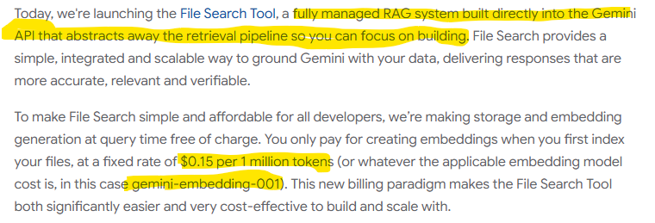

Slide 49
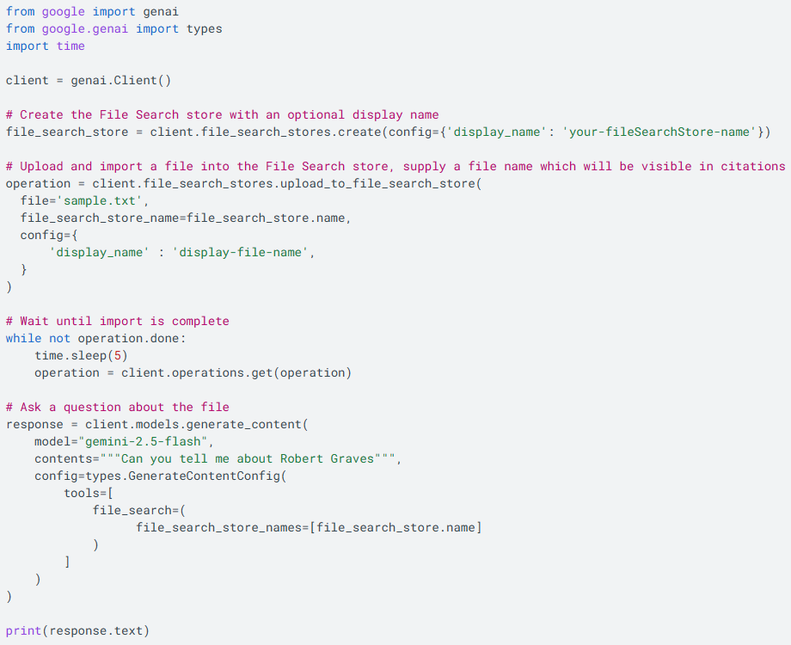

Slide 50
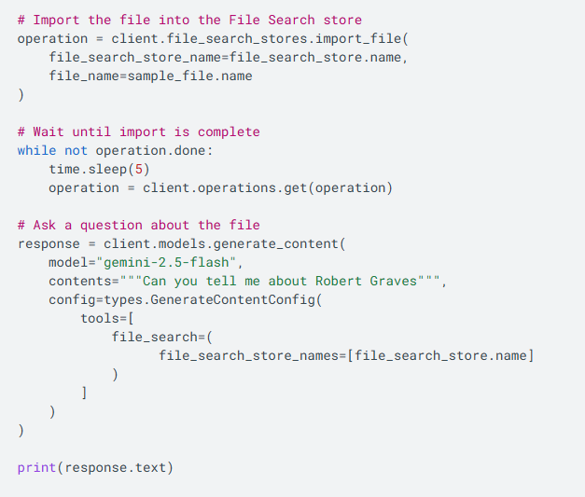

Slide 51
TOON
(Token-Oriented Object Notation)

Slide 52
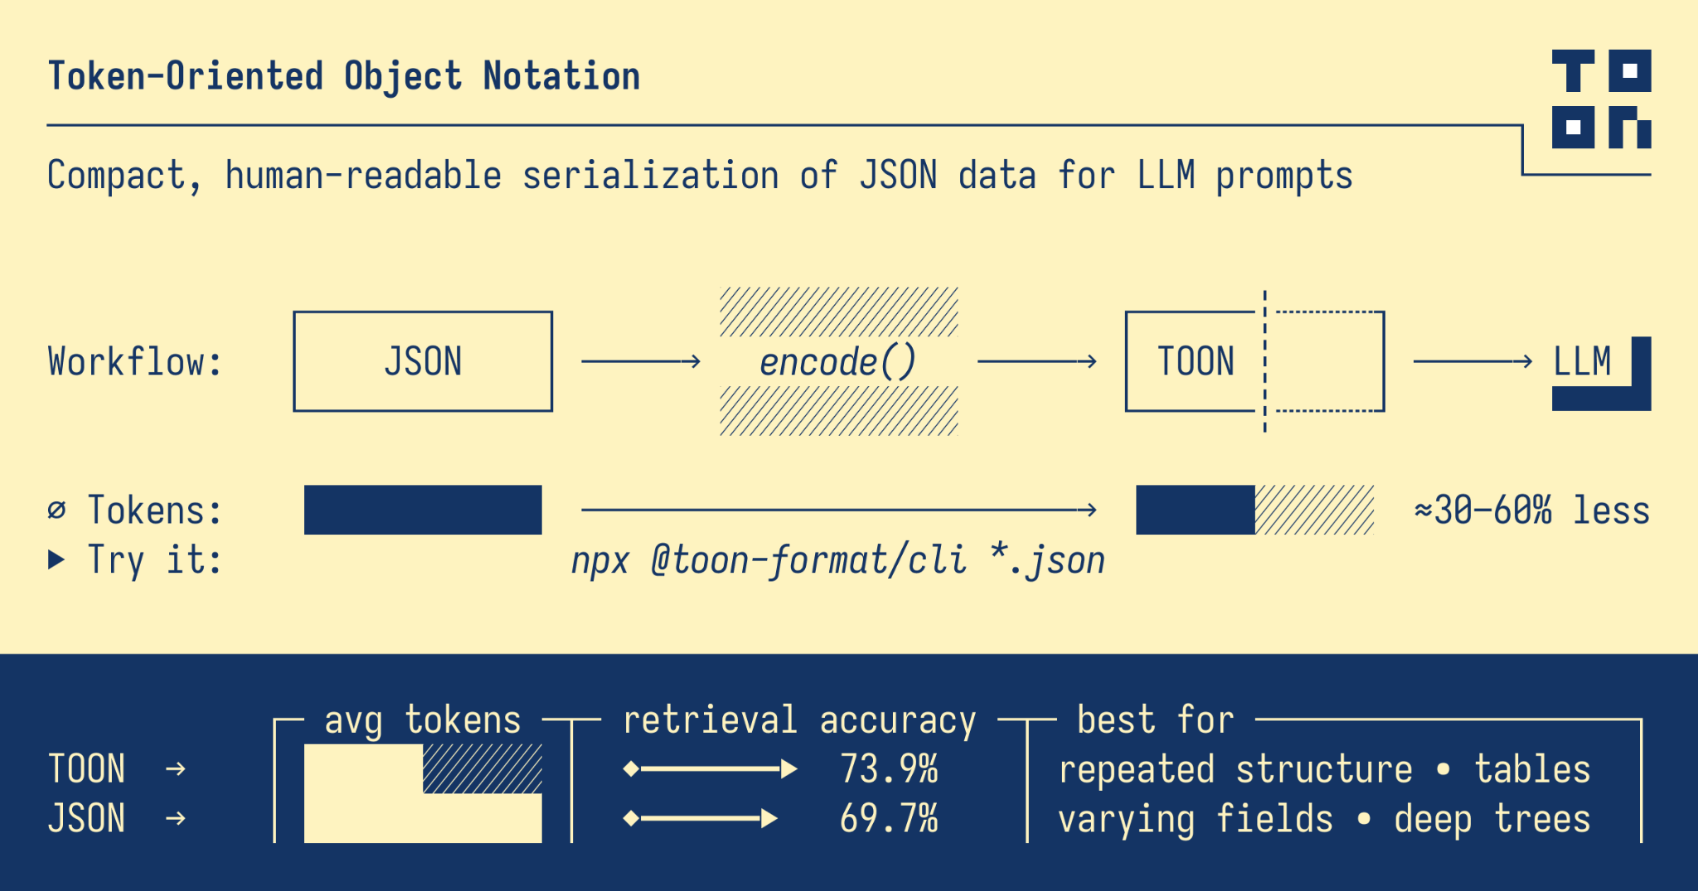
Reduce tokens with this new format

Slide 53
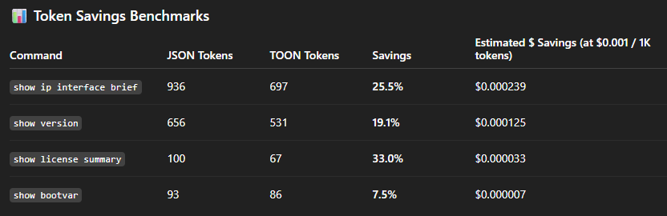
Personal testing results

Slide 54
RAG Lab Agenda
Lab One: Exploration
Embeddings
Splitting
Storage
Lab Three: Talk to Networks
Cisco pyATS
Cisco DevNet Always On Sandbox
Routing Table
6 Step process
JSON -> TOON
Lab Two: Talk to PDFs
Large Language Model
Embeddings Model
Source
Loader
Semantic Chunking
Storage
Retrieval
PDF Buddy
Lab Four: Talk to Networks
6 Step Process
Router Buddy

Slide 55
Labs: Getting started
automateyournetwork/NAF_AC4_RAG: RAG Labs for NAF Autocon4
GitHub
Git
Python
Visual Studio Code (VS Code)
cURL
Postman (GUI)
LangChain
LangGraph
ChromaDB
Large Language Model – openAI ChatGPT4o
Embeddings Model – openAI Embeddings
Vectors
Semantic Chunking
Streamlit
Cisco DevNet Always-On Sandbox
Cisco IOS-XE
Cisco pyATS

Slide 56
visit
Automateyournetwork/CiscoLive2026_VibeOpsLounge
Clone
the repo
Follow
the README

Slide 57
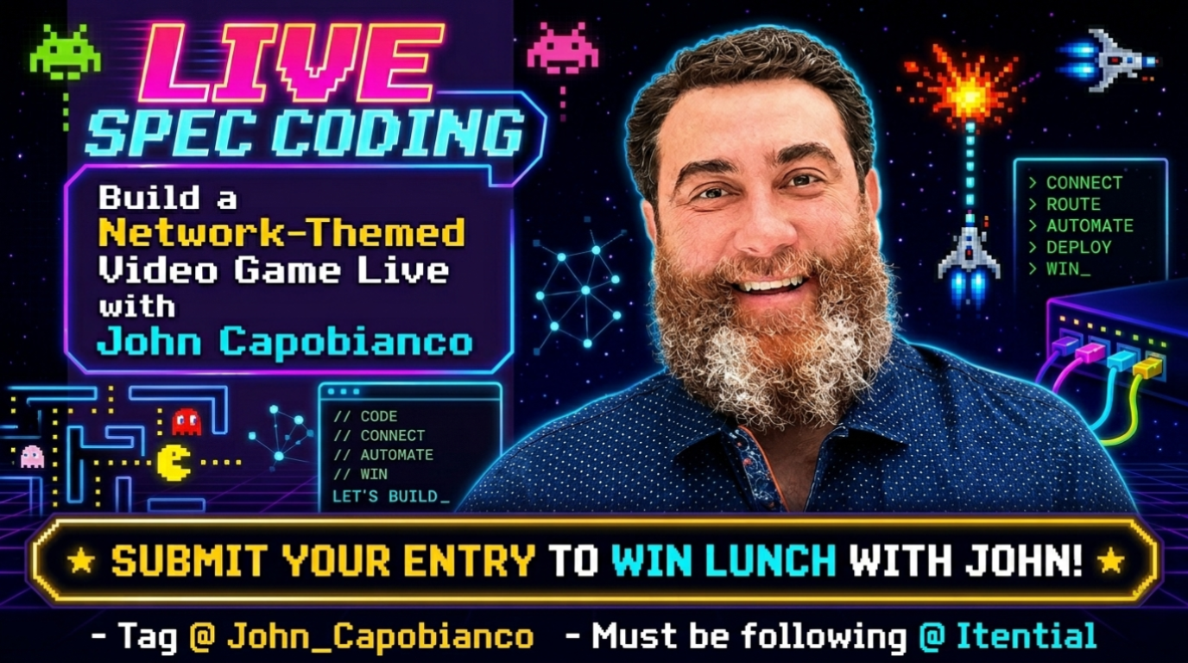

Slide 58
Join the

Slide 59
All the presentations from the VibeOps Lounge are available on GitHub.
github.com/automateyournetwork/CiscoLive2026_VibeOpsLounge

